Slide 1


Slide 2
GAME INFROMATION SYSTEM
A GUI Based Game Management System Provide Information About the Game
Submitted By:
Krish Kachhadiya (92300527035)
Akshit Baleliya
(92300527101)
Jay Kakadiya
(92300527099)
Course: BCA – Semester V
Subject: Python
Submitted To:
Prof. Kinjal Raval
Faculty of Computer Application
Marwadi University
Rajkot, Gujarat
Academic Year: 2025–2026

Slide 3

CONTENTS
Chapters | Particulars | Page No.
1 | SYNOPSIS | 1
2 | PREAMBLE General Introduction Module description | 2-3
3 | TECHNICAL DESCRIPTION Hardware Requirement Software Requirement | 4
4 | SYSTEM DESIGN AND DEVELOPMENT Flowchart Screen Design & Coding | 5-7
5 | CONCLUSION | 8
6 | LEARNING DURING SIP | 9-10
7 | BIBLIOGRAPHY Online References Offline References | 11

Slide 4
SYNOPSIS
Project Title: Game Information System.
A CSV-Based Game Information System using Python and Tkinter GUI.
This application allows for recording, searching, updating, and managing Games Records , using structured CSV file data storage.
User-friendly interfaces facilitate all core game tracking operations with validation, prevention of duplicate games, and easy navigation.

Slide 5
PREAMBLE
GENERAL INTRODUCTION
Allows users to add, view, search, update, and delete game records
It helps users manage game data efficiently without relying on manual spreadsheets.
Records are stored in a structured CSV file format for easy access and persistence.

Slide 6
PREAMBLE
MODULE DESCRIPTION
Modules:
1. Add Game
2. Display Game
3. Search Game
4. Update Game
5. Delete Game
6. Sort by Rating
7. Filter Games by Platform
8. Get Highest rated games

Slide 7
TECHNICAL DESCRIPTION
Hardware Requirements:
Any system capable of running Python
Minimum 512 MB RAM
Minimal disk space required to store CSV trade record files
Software Requirements:
Python 3.x (latest stable version recommended) with Tkinter module included
Any text editor or IDE for code development (e.g., VS Code, PyCharm)
Graphical desktop environment to run the Tkinter GUI application
Python execution environment (command line or terminal) to launch the app

Slide 8
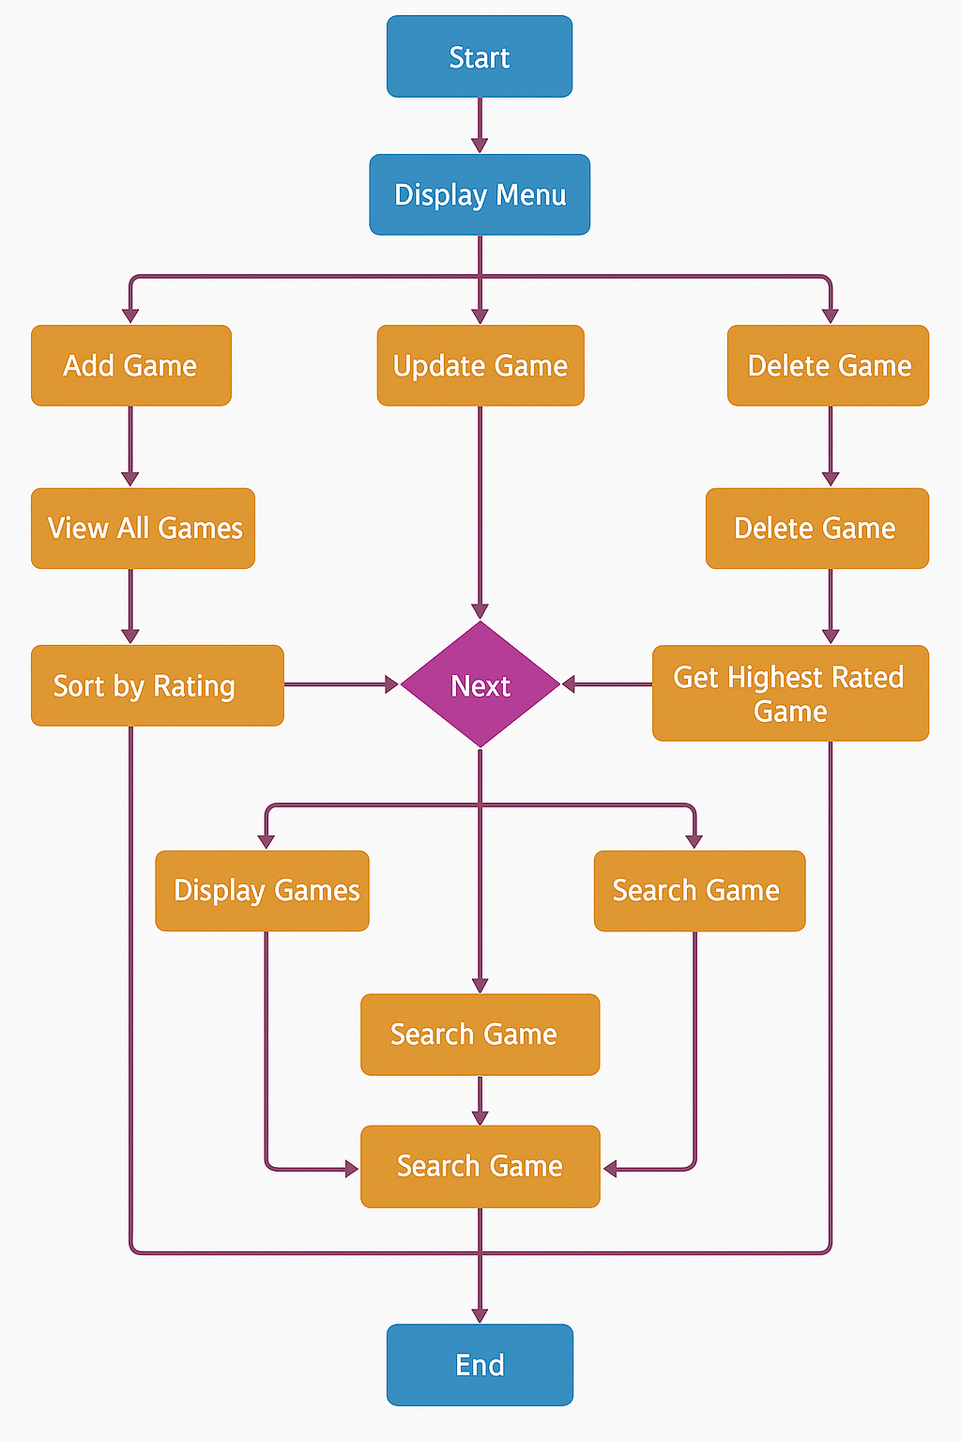
SYSTEM DESIGN
Flowchart

Slide 9

SYSTEM DESIGN
Screen Design
Screen Design (CLI)
The project uses a text-based interface displayed on the command line. Upon running the program, the user is presented with a numbered menu containing all major functionalities:
Each menu option leads to a respective set of prompts that collect or display data related to option selling trades.

Slide 10
SYSTEM DESIGN
Coding
Python modules used: csv, os, tkinter
Core functions: add_game(), display_game(), delete_game(), update_game(), search_game(), sort_by_rating(), filter_games_by_platform(), get_highest_rated(), initialize_file()
Uses CSV file for data storage.

Slide 11
CONCLUSION
Lightweight, efficient Game Information system Gamers.
Removes dependency on complex databases.
Future upgrades: analytics ,database integration.

Slide 12
LEARNING DURING SIP
Technical
Python programming: modular and structured coding.
CSV file handling: secure read/write operations.
Data validation: unique composite keys.
CLI design: menu-driven interaction.

Slide 13
LEARNING DURING SIP
Domain Knowledge
Game record-keeping: importance for Game Infomration.
Analysis: Game performance assessment and all about that games informations.

Slide 14
BIBLIOGRAPHY
ONLINE
W3Schools (Python File Handling)
GeeksforGeeks (Python Projects)
OFFLINE
Notes from Python book

Slide 15
BIBLIOGRAPHY
Offline References
College lecture handouts for Python programming and CLI development.
Mini project journal provided by faculty, offering guidance on system design diagrams and documentation practices.

Slide 16


